Slide 1
Modern Cloud Apps
Michelle Xie
Andrew Cobb
Azure Specialist – Application Development
Melbourne, Australia

Slide 2

Contoso Sports League Association
Largest sports franchise in the world
E-commerce website sells merchandise to sports fans (.Net, Co-located)
Backend website supports call center (View, take customer orders)
Credit card payments (50K/day)
Need to be PCI DSS Level 1 compliant
Third-party gateway processes payments

Slide 3

Contoso Sports League Association
SQL Server 2014: customer data, profile data
Order fulfilment process:
Order comes in
Message to inventory management system
Database lookup for order details
Locate items in inventory or backorder
Confirmation email sent to customer
Usernames and passwords stored in the same database as merchandise
information (wants a customized look-and-feel identity solution)
New functionality to website: Offers API service (ASP.Net Web API, scalable)
Data Analytics: move OLTP database to data warehouse

Slide 4

What do they need?
Move infrastructure to PaaS solutions
Maintain PCI compliance
Ensure data privacy and protection
Provide better management of usernames and passwords
Scale API independently of website
Provide failover mechanism
Data warehouse for analytics

Slide 5



They are curious about…
How can Azure Trust Center help with PCI compliance?
Can solution scale to meet customer demand, and allow secure access by call center and warehouse?
Can we do penetration testing in Azure?
Can we leverage CloudTest in Azure?
What options are available for performance monitoring?
What is the impact of pausing Azure Data Warehouse on our data?
Can’t we use Azure SQL Database for our data warehouse?

Slide 6
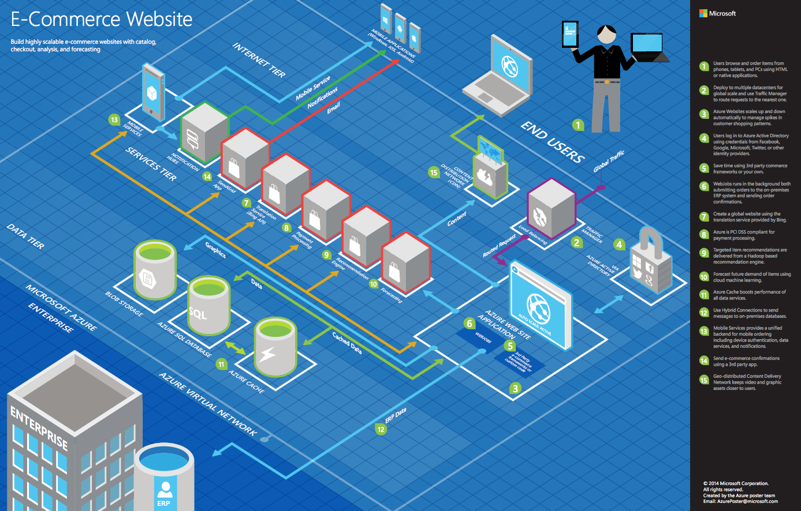
Common scenarios

Slide 7
Task 1: Design the solution
Outcome
Design a solution and prepare to present the solution to the target customer in a 15-minute chalk-talk format
Go to:
aka.ms/mcw-melb-design
Timeframe
60 minutes
Business needs (10 minutes) | Respond to questions outlined in your guide and list the answers on a flipchart.
Design (35 minutes) | Design a solution for as many of the stated requirements as time allows. Show the solution on a flipchart.
Prepare (15 minutes) | Identify any customer needs that are not addressed with the proposed solution. Identify the benefits of your solution. Determine how you will respond to the customer’s objections. Prepare for a 10-minute presentation to the customer.
Notes:
Go to: aka.ms/mcw-melb-design

Slide 8
Task 2: Review the solution
Outcome
Present a solution to the target customer in a 15-minute chalk-talk format
Timeframe
30 minutes (15 minutes for each team to present and receive feedback)
Directions
Pair with another table.
One table is the Microsoft team and the other table is the customer.
The Microsoft team presents their proposed solution to the customer.
The customer asks one of the objections from the list of objections in the case study.
The Microsoft team responds to the objection.
The customer team gives feedback to the Microsoft team.

Slide 9

Target customer
Miles Storm
CEO of Contoso Sports League Association
Primary audience is business and technology decision makers
Usually talk to Infrastructure Managers or to application sponsors or to IT or developers that report to application sponsors

Slide 10
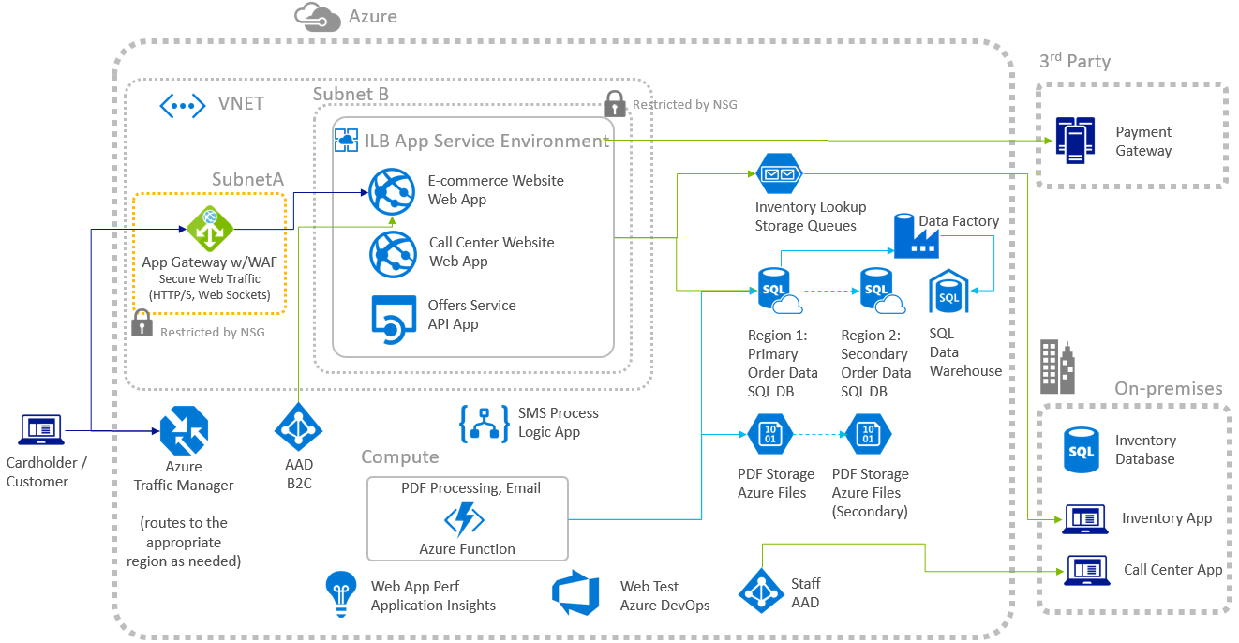
High-level Architecture

Slide 11
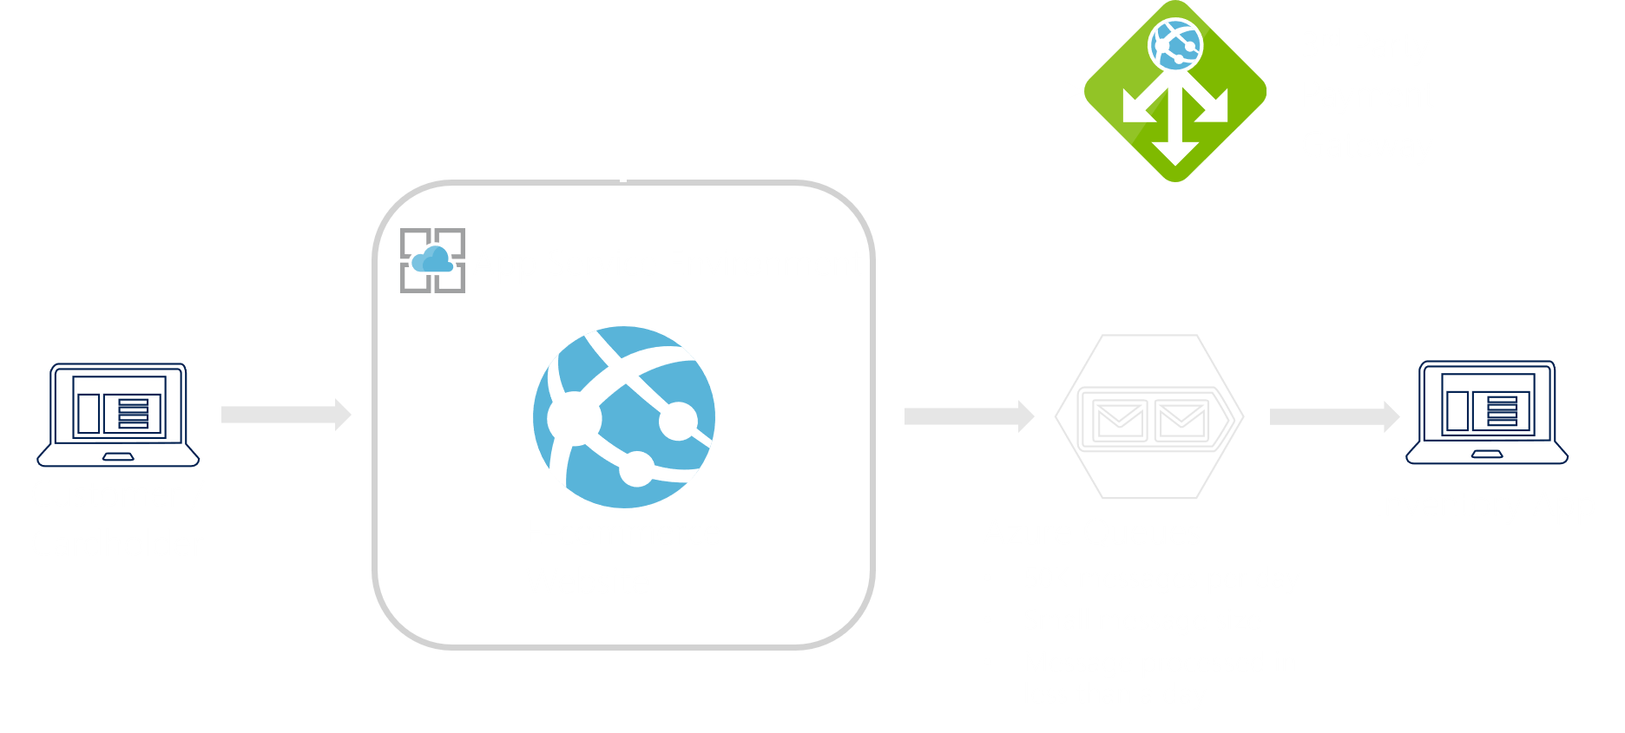
Order Fulfilment
Service Bus or Azure Queues?
More info: Aka.ms/mcw-queues-2019

Slide 12

Notifications
Use Logic App
Frequency trigger executes stored procedure
Twilio connector action to send SMS message
Outlook connection action to send an email

Slide 13

Offers Service
Migrate to Azure App Service
Enable CORS
Consider API Management

Slide 14
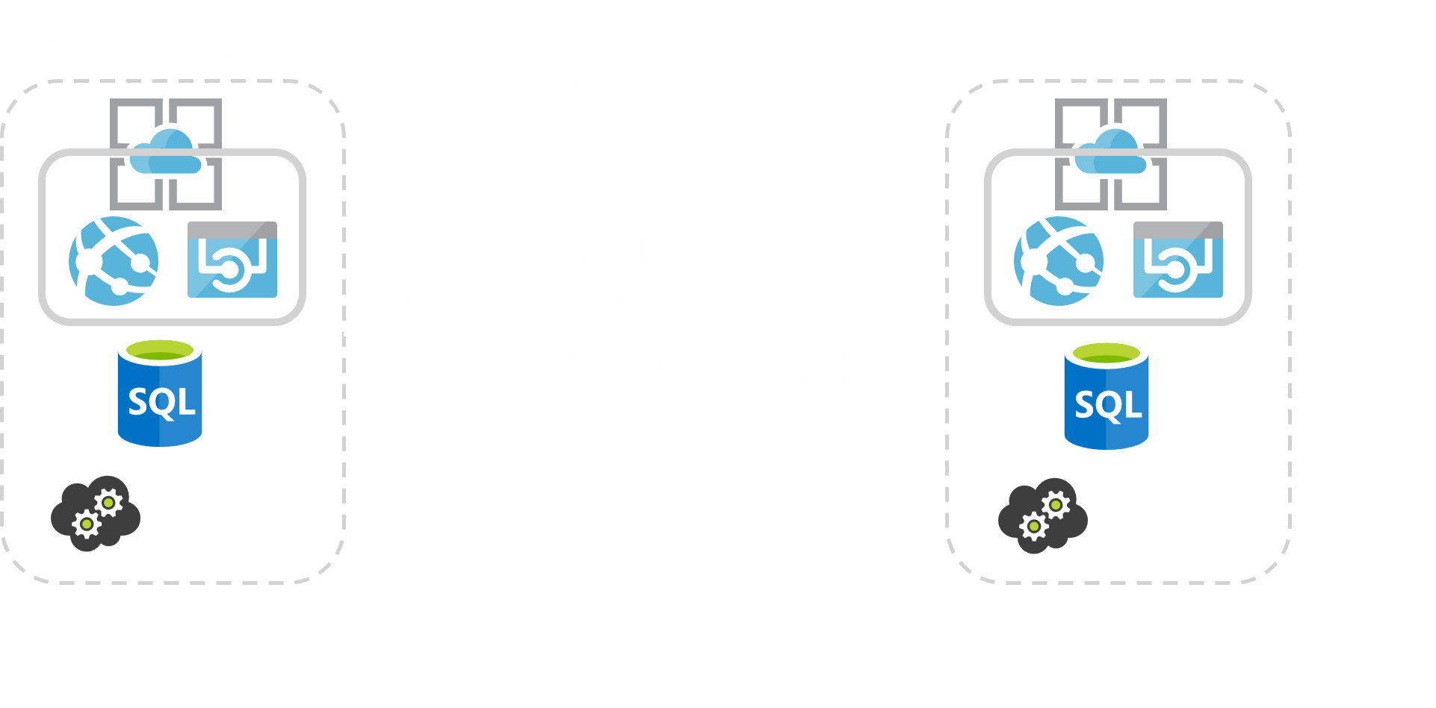
Geo-Resiliency

Slide 15
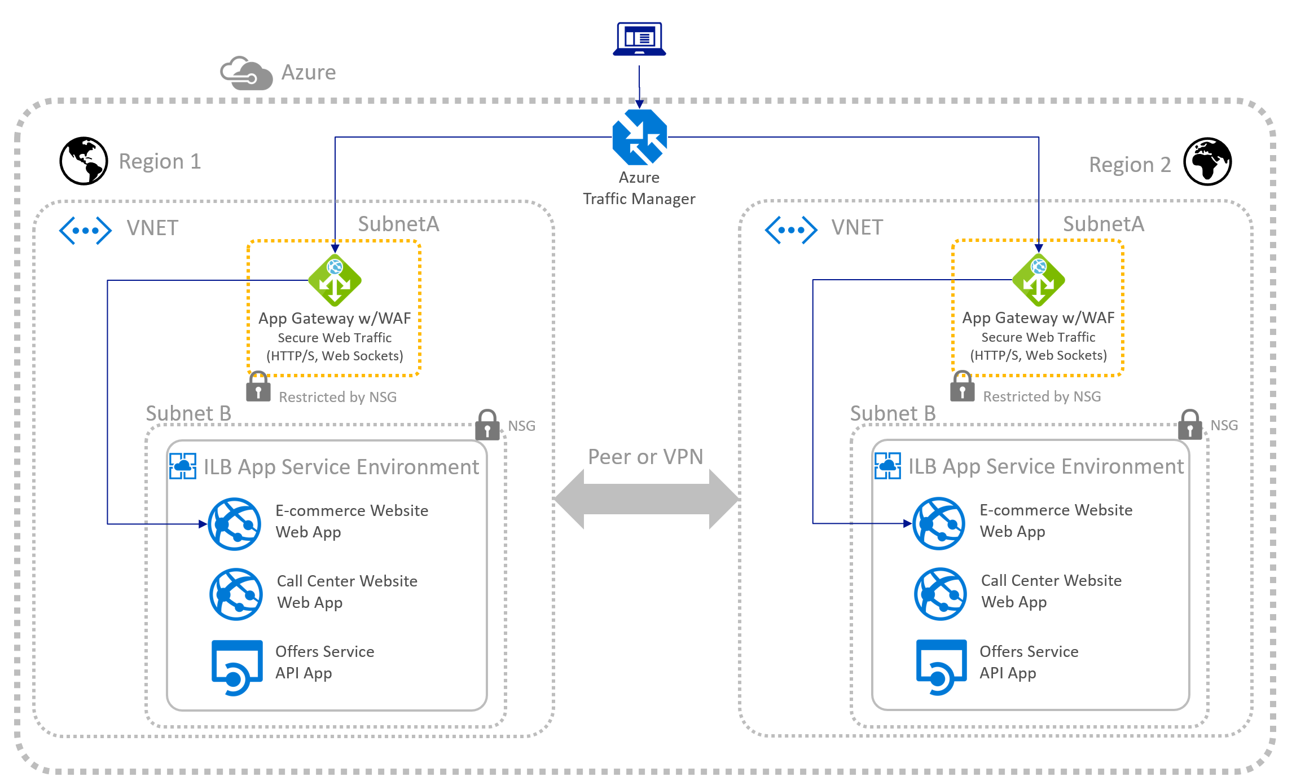
Geo-resiliency
https://aka.ms/mcw-lb-2019

Slide 16
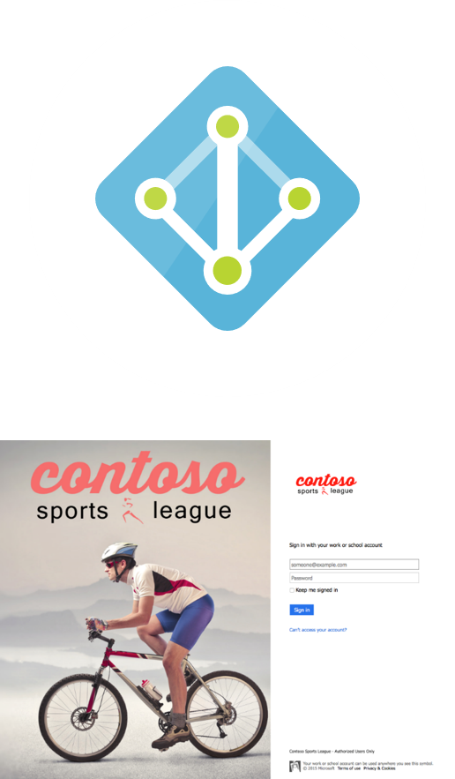
Access Control
Use Azure Active Directory
Customize Branding
AAD Reports
Apply to Call Center Website

Slide 17

PCI Compliance
Web Apps certified for PCI Compliance
Restrict outbound traffic using Network Security Groups
Use Application Service Environment
Antivirus handled by Azure
Subnet
Restricted by NSG

Slide 18
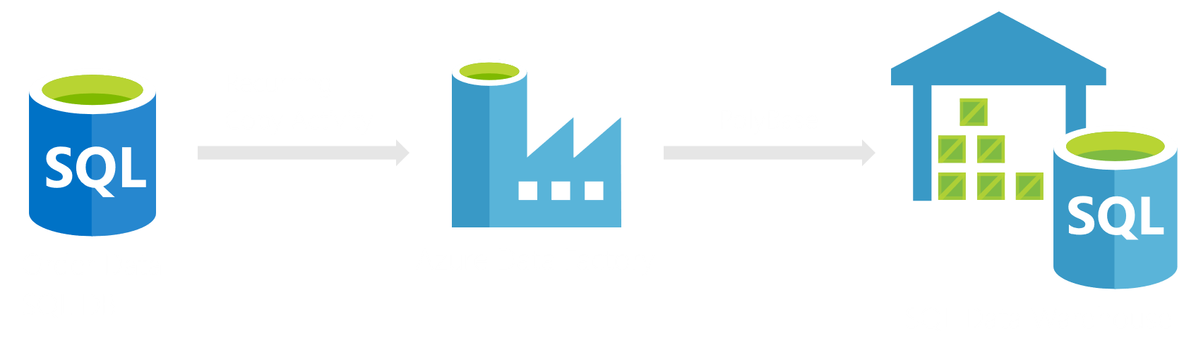
Data Warehouse
Azure Synapse (former Azure SQL Data Warehouse)

Slide 19
Hands-on Lab
Learning objectives
Deploying and configuring Azure Web Apps
Configuring web apps for authentication with Azure AD and Azure AD B2C
Instrumenting and load-testing applications with App Insights
Automating back-end services using Azure Functions and Logic Apps

Slide 20
Hands-on lab: Let’s build stuff…
Hands on Lab:
Aka.ms/mcw-melb-lab
Lab Link:
http://bit.ly/35ivLdE
Activation Code:
ACTIVATE4905
Instructions:
Fork and clone the GitHub repository
Follow the ‘Lab Instructions’ page
All the code you need should be in the ‘Contoso Sports League’ folder
Ask us questions and have fun!
Notes:
Go to: Aka.ms/mcw-melb-lab

Slide 21
Thank you!
For free swag, let us know how we went at:
aka.ms/CloudMel28Nov
For slides and solutions, please reach out to:
Michelle.Xie@Microsoft.com

